Slide 1
离散回归II

Slide 2
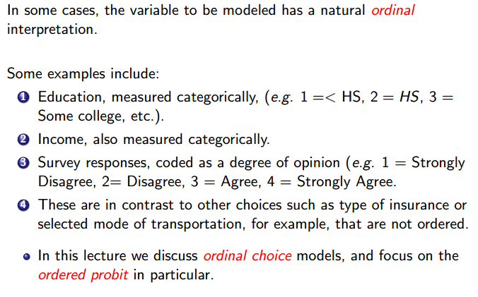
Ordered Probit Model

Slide 3

Ordered Probit Model
Ordered probability models are derived by defining an unobserved variable z that is used as a basis for modeling the ordinal ranking of data.

Slide 4
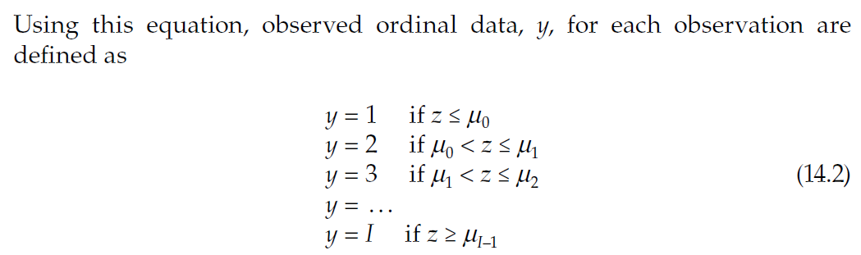

Ordered Probit Model
where μ are estimable parameters (referred to as thresholds) that define y, which corresponds to integer ordering, and I is the highest integer ordered response.

Slide 5
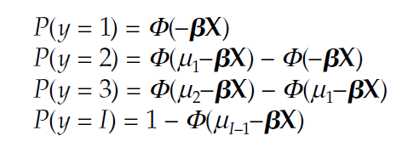

Ordered Probit Model
The μ are parameters that are estimated jointly with the model parameters.
If ε are assumed to be normally distributed across observations with mean = 0 and variance = 1, an ordered probit model results with the ordered selection probabilities being

Slide 6
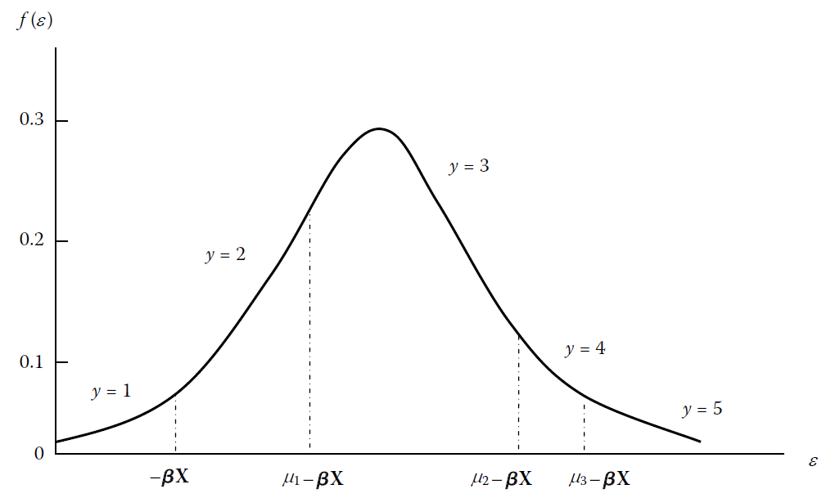
Ordered Probit Model

Slide 7


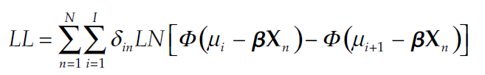
Ordered Probit Model
Threshold μ₀ is set equal to 0.
For estimation, the above is written as
The likelihood function is (over the population of N observations)
where δ_{in} is equal to 1 if the observed discrete outcome for observation n is i, and zero otherwise.

Slide 8
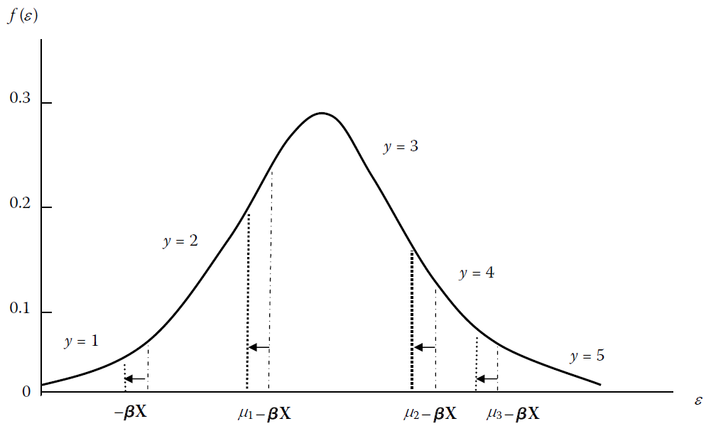
Ordered Probit Model

Slide 9
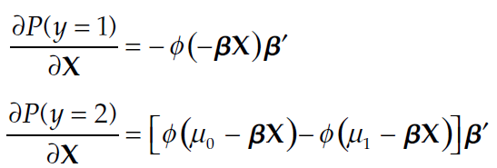
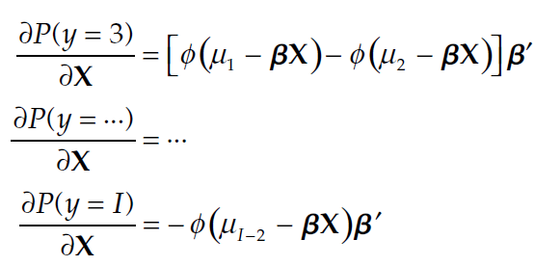
Ordered Probit Model
To obtain a sense of the direction of the effects on the interior categories, marginal effects are computed for each category

Slide 10
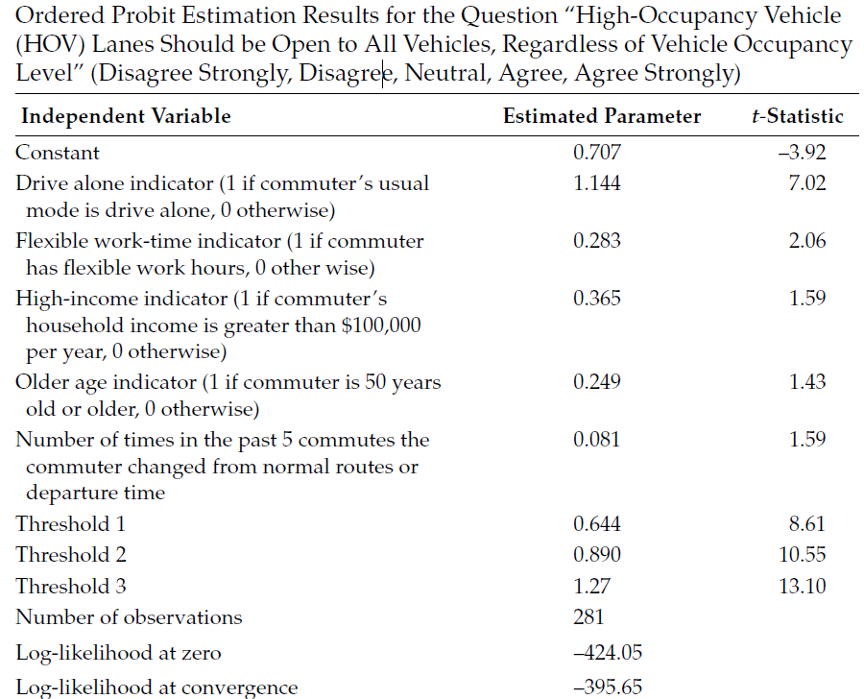
Ordered Probit Model

Slide 11
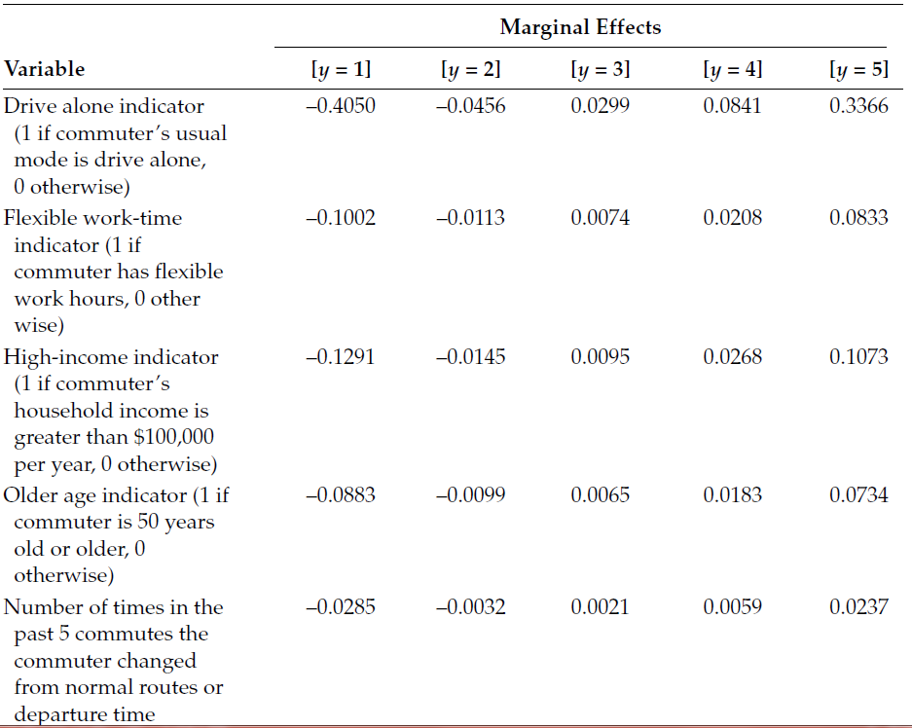
Ordered Probit Model

